Slide 1
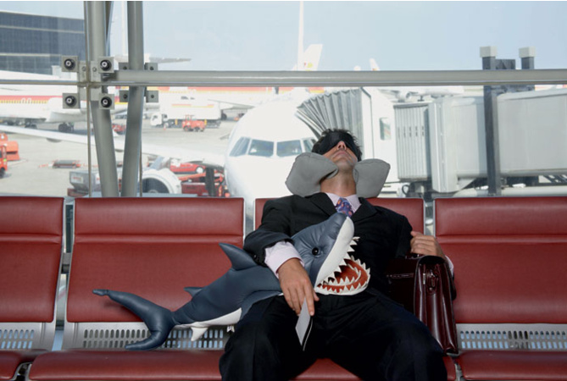
Bad dreams come only half true here

Slide 2




Use a smiley to express your opinion about
lesson’s material | teacher’s help | your work | classmates’ cooperation | home task
great | OK | could be better | terrible

Slide 3
